Slide 1

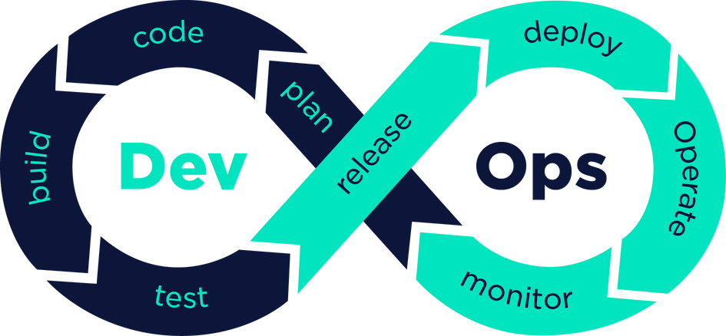
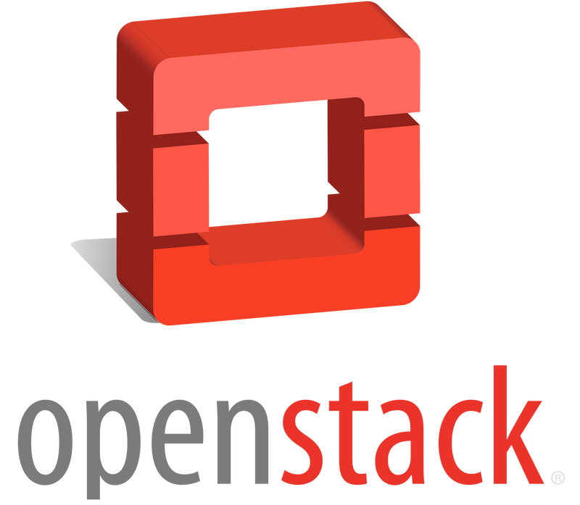

Simple
Devops Project
on
OpenStack Cloud
@cloudengineer

Slide 2



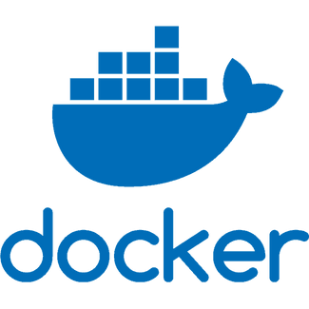





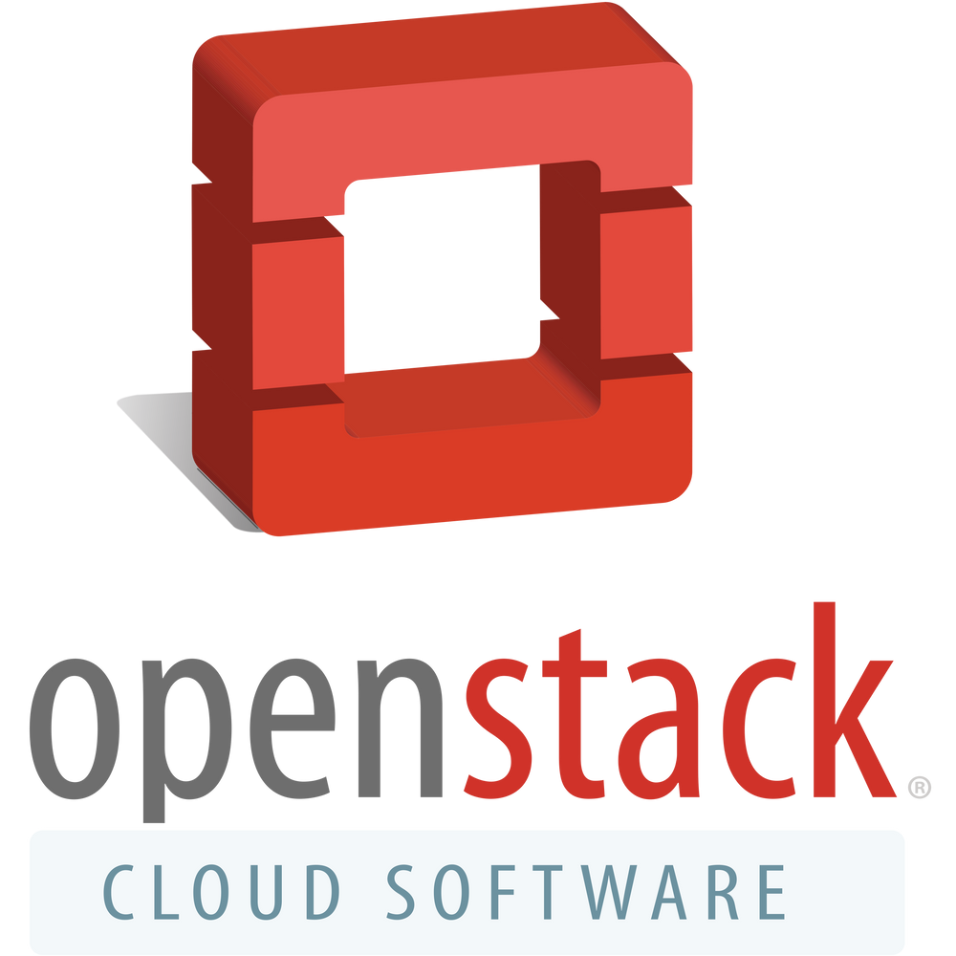
Simple DevOps Project on
OpenStack
Instance
Notes:
Then Create a Ubuntu Instance in OpenStack Cloud

Slide 3

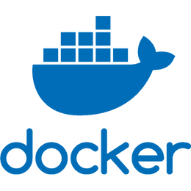
Simple DevOps Project on
OpenStack
Instance
User & Visitor
User & Visitor
WebSite Backend

Slide 4
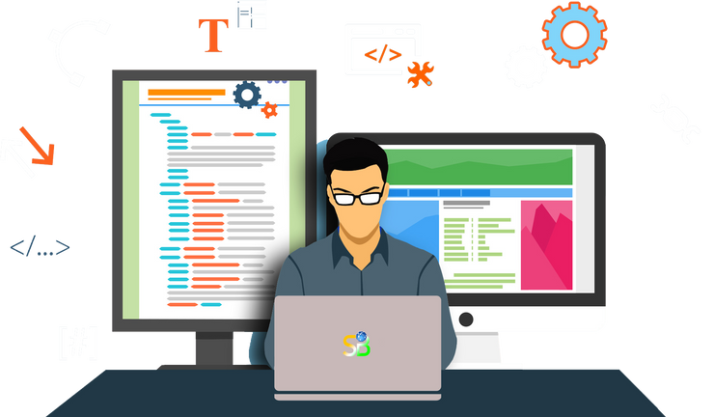

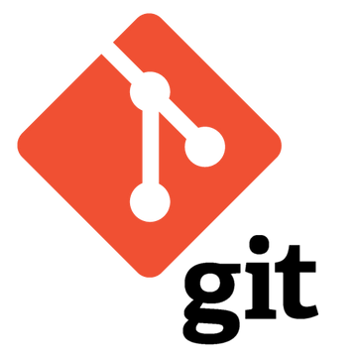
Simple DevOps Project on
OpenStack
Instance
Push Code
Operation
Developer

Slide 5

Simple DevOps Project on
OpenStack
Let's Going to The Practical

